Slide 1
Word Study k-12: An Overview of the Research Base and Instructional Strategies
Presenters: Shannon Nichols, Shannon Francis, Carlene LaGrasso

Slide 2
Learning Outcomes
Review current research in order to:
Understand the need for more systematic, intensive, and effective vocabulary instruction
Gain awareness for best practice
Learn efficient and effective research-based vocabulary instruction strategies

Slide 3
Why do we need to teach vocabulary?
Learning is fundamentally and profoundly dependent upon vocabulary knowledge
Vocabulary knowledge is highly correlated with overall reading achievement
Vocabulary deficiencies are a primary cause of academic failure in grades 3-12
Vocabulary knowledge affects a student’s ability to participate fully in both social and academic activities
The Common Core requires it
Notes:
One of the key requirements of the Common Core State Standards for Reading is that all students must be able to
comprehend texts of steadily increasing complexity as they progress through school. By the time they complete the
core, students must be able to read and comprehend independently and proficiently the kinds of complex texts commonly
found in college and careers.
In order for students to read grade-level text independently and proficiently, there is a great volume of words student to need know…

Slide 4
Why do we need to teach vocabulary?
Vocabulary is one of the primary causes of the achievement gap, and many students from low-income households enter school with smaller vocabularies than their more affluent peers.
 | Words heard per hour | Words heard in a 100 hr week | Words heard in a 5,200 hr year | Words heard in 4 years
Welfare | 616 | 62,000 | 3 million | 13 mil
Working Class | 1,251 | 125,000 | 6 million | 26 mil
Professional | 2,153 | 215,000 | 11 million | 45 mil
Notes:
Students who are behind need to learn more words. This can only happen if we all make vocabulary and word study a priority in our materials and instruction.
From there, usually the achievement gap widens-like the Matthew Effect “the rich get richer and the poor get poorer”
In fact, at most between 5 and 15 percent of new words encountered upon first reading are retained, and the weaker a
student’s vocabulary is the smaller the gain (Daneman & Green, 1986; Hayes & Ahrens, 1988; Herman, Anderson, Pearson,
& Nagy, 1987; Sternberg & Powell, 1983). Yet research shows that if students are truly to understand what they
read, they must grasp upward of 95 percent of the words (Betts, 1946; Carver, 1994; Hu & Nation, 2000; Laufer, 1988).
Perhaps facilitate activity with missing words

Slide 5
What are the different types of vocabulary/How do we choose which words to teach?
Beck and McKeown, & Kucan (2008) describe three tiers of words in terms of the words’ commonality (more to less frequently occurring) and applicability (broader and narrower).
https://prezi.com/o-e04jzmmu3a/tiered-vocabulary/
Notes:
Different authors have coined different terms for these three tiers but the most well know is Beck, McKeown, and Kukan’s three tiers

Slide 6
 | Tier One | Tier Two | Tier Three
AKA | Conversational Vocabulary | Core Academic Vocabulary | Content-Specific Vocabulary
Description | Basic words that most children know before entering school | Words that appear frequently in texts and for which most students already have conceptual understanding | Uncommon words that are typically associated with a specific domain Heavily scaffold by authors and teachers
Examples | clock, baby, happy | sinister, fortunate, adapt | isotope, peninsula, onomatopoeia
Notes:
Which words are often explicitly defined by the text?
Which words do you think content are teachers most often define prior to students encountering them?
Which words do you think are less likely to be defined explicitly within a text, and as a result, have the ability to significantly impede comprehension?

Slide 7
Common Core Takeaway
Teachers need to be alert to the presence of Tier Two words and determine which ones need careful attention.
Resource: Academic Word Finder
an online tool for identifying academic vocabulary (Tier Two vocabulary) within a text
http://achievethecore.org/academic-word-finder/
Notes:
Appendix A of the Common Core states that
Because Tier Three words are obviously unfamiliar to most students, contain the ideas necessary to a new topic, and
are recognized as both important and specific to the subject area in which they are instructing students, teachers often
define Tier Three words prior to students encountering them in a text and then reinforce their acquisition throughout
a lesson. Unfortunately, this is not typically the case with Tier Two words, which by definition are not unique to a
particular discipline and as a result are not the clear responsibility of a particular content area teacher. What is more,
many Tier Two words are far less well defined by contextual clues in the texts in which they appear and are far less
likely to be defined explicitly within a text than are Tier Three words. Yet Tier Two words are frequently encountered
in complex written texts and are particularly powerful because of their wide applicability to many sorts of reading.
Teachers thus need to be alert to the presence of Tier Two words and determine which ones need careful attention.
From Appendix A of the common core

Slide 8
Additional Words to Teach
Research shows that students will achieve higher scores on standardized tests if they know the vocabulary of the standards
1. Find out which words are "your" words.
2. Read the CCSS for your grade level, highlighting the words you think your students won't know. Then go back to each year prior to yours and highlight those words.
3. Next, create a pre-assessment for your students with these critical words. A simple list of words followed by columns marked "Yes" (I understand), "No" (I don't understand) and "Maybe" (I might understand) is a start.
4. Use this information and your professional judgment to decide which words have not yet been mastered and require instruction.
Reference:http://www.edutopia.org/blog/teaching-ccss-critical-vocabulary-marilee-sprenger

Slide 9
What is best practice for teaching vocabulary?
Think-Pair-Share
Read “What Do We Know from Research?” (pg. 1 in packet) and summarize what it says about effective vocabulary instruction/implications for teaching
Notes:
Conclusion: Both direct instruction and learning vocabulary in context are necessary components of vocabulary instruction
Until relatively recently, debates about how to teach vocabulary centered on direct instruction versus learning from context through wide reading. Advocates for the context approach pointed to the number of words students need to learn as being impossible to teach directly within the school day, week, or year. Thus, emphasis needed to be placed on wide reading. This was the origin of the “25 books a year programs” prominent in the mid 1990’s and still present in some states’ standards. Direct instruction advocates argued that a focus on growing “word awareness” through instruction was essential.
Read-pair-share activity and whole group discussion
Research suggests that if students are going to grasp and retain words and comprehend text, they need incremental,
repeated exposure in a variety of contexts to the words they are trying to learn.-informal talk, discussion, reading, being read to responding to what is read
Although direct study of language is essential to student progress, most word learning occurs indirectly and unconsciously through normal reading, writing, listening, and speaking (Miller, 1999; Nagy, Anderson, & Herman, 1987).

Slide 10
What is best practice for teaching vocabulary?
Combine the following:
Immerse students in rich oral language and wide reading (learning in context)
Teach individual words (direct instruction)
Teach morphology/word parts (direct instruction)
Provide repeated exposure to words
-Vocabulary Their Way: Word Study with Middle and Secondary Students (8)
Notes:
Morphology refers to instruction that helps students understand the processes of word formation in English-how prefixes, suffixes, base words, and Greek and Latin word roots combine. Understanding these processes will “generate” student learning about thousands of words they will encounter in their instructional and independent reading
Stat says that the average high school students needs to acquire 3000 words per year to graduate-therefore, teaching individual vocabulary words is not enough

Slide 11
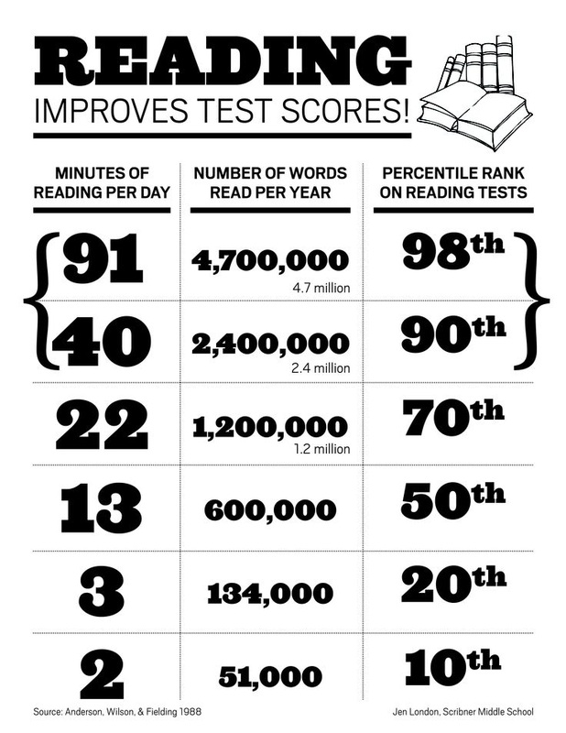
Strategies for immersing students in rich language
Read aloud to your students
Provide frequent and extensive time for students to read
Provide students with texts they can read independently
Teach strategies for learning words independently
Spark engagement
Notes:
Although direct instruction is essential to vocabulary development, this in itself is not sufficient. Students need to engage in a volume of wide-ranging reading of texts they can read independently. Nothing here should be construed as lessening the essential importance of a volume of reading to vocabulary acquisition.
Getting students to read more may be the most valuable thing you can do to improve their vocabulary.
The average amount of time spent reading for all grades is 7.1 minutes a day in public schools around the nation.
Using context clues, breaking words into parts and recognizing roots and affixes
https://www.teachingchannel.org/videos/reading-teaching-strategy

Slide 12
Strategies for teaching individual vocabulary words
Anita Archer Method
Read the word by word parts and have the students repeat
Read the complete word and have the students repeat
Discuss any word parts students already recognize
Provide the definition, examples and non-examples
Assign an action for the word and have the students pantomime the action while saying the word
Provide several sentences that use the word in different ways; give the students a signal to say the word when the word is used in the sentence
Repeat exposure
Notes:
Reading word parts serves two purposes: providing proper pronunciation and showing students how words break into parts while also allowing students to recognize word parts they may already know
https://www.youtube.com/watch?v=fr7yRYegjb8

Slide 13
Strategies for teaching individual vocabulary words
Robert Marzano Method (pgs. 2-4)
Provide a description, explanation, or example of the new term
Ask students to restate the description or explanation in their own words
Ask students to construct a picture or symbolic representation of the term
Repeat exposure: engage students in activities that help them add to their knowledge; have students discuss terms with one another; involve students in games
Resource: Frayer Model (pg. 11)
Notes:
https://www.teachingchannel.org/videos/teaching-hard-vocabulary-words

Slide 14
Strategies/activities for providing repeated exposure to words
Model the use of words in your classroom
Engage students in group/partner activities and games (refer to packet)
Word Wall activities (pg. 5)
Pictogram/Picto-Guess (pg.6)
Vocab Word Cards (pg.7)
Meaning Matrixes (pgs. 8-10)
Vocab Cube (pg. 12)
Vocab Pictionary
Notes:
Model the use of the words in your classroom. The more often that students hear them, the more automatic their use of those words will become.
Start a Word Wall and engage students in daily activities using the Word Wall
If time remains, play one of these games

Slide 15
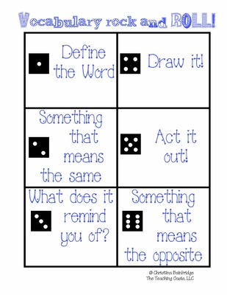
Strategies/activities for providing repeated exposure to words
Vocab Bingo:
Students:
1) fold a scrap piece of paper to make a bingo board
2) write a vocabulary word in each box
3) as the teacher reads the definition, example, non-example, or sentence for each vocabulary word, place chip on correct vocabulary word

Slide 16
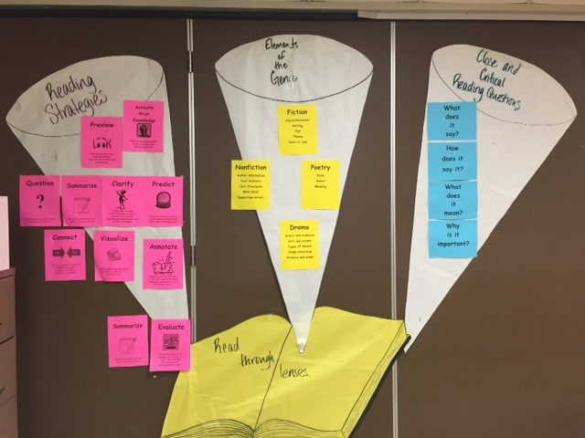
Word Walls

Slide 17
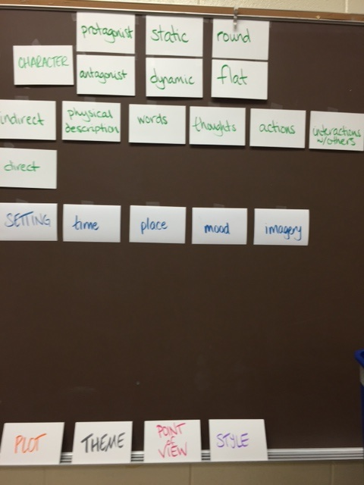
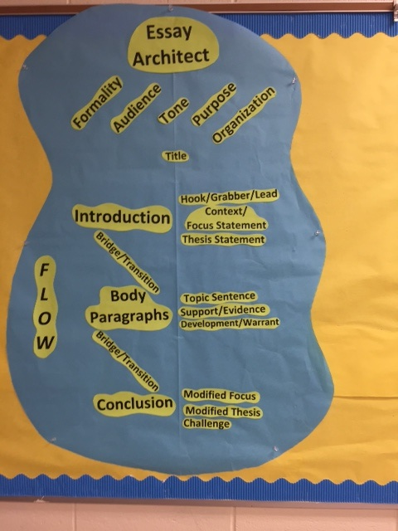

Slide 18
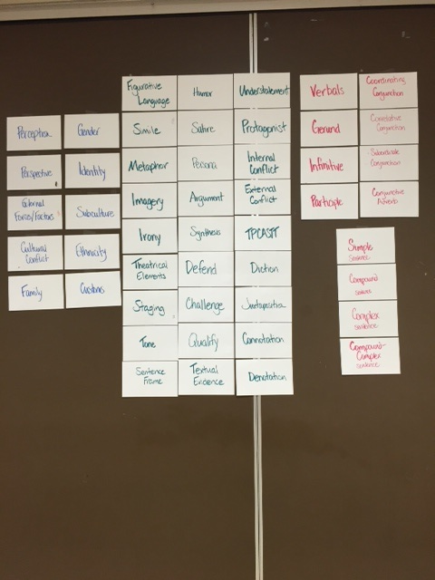
For more Word Wall information, strategies and resources, refer to pages 13-18 in your packet.

Slide 19
Strategies for teaching morphology and word parts
Word sorts
Manipulate word parts
Online activities
Interactive notebooks
Videos/songs
Examine related words
Vocabulary Paint Chips
Notes:
With or Without Words Their Way: elementary teachers use WTW spelling inventories to assess, create groups based on instructional level (5 different), and provide instruction & practice in class & at home throughout the week, and re-assess at end of week
HOW? Get parent volunteers to help with preparation, schedule groups within guided reading time, once routines are established, goes smoothly
Word sorts – done independently, in small group or with partners: based on chunks, sounds, patterns, roots or affixes
Manipulate words:
Change Up – change a letter or chunk using repeated practice with the same learned pattern – back, stack, crack, attack
Build a word – variety of ways – any type of letters – magnetic, scrabble, written - vowels or patterns in special color – add prefixes or suffixes
Online activities – with ipads or computer lab time; centers in the classroom there are classroom computers (Spelling City)
Interactive notebooks – written “play” of words and practice in notebooks; students self-monitor progress & words to continue to practice after assessment
Videos/songs – that teach about word parts or give examples – great visuals or songs help them remember
Looking at related words – words we can build upon or find synonyms for – unlock thousands of words

Slide 20
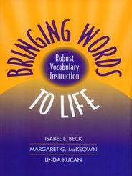
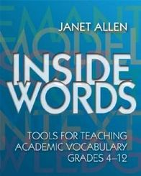
Resources

Slide 21
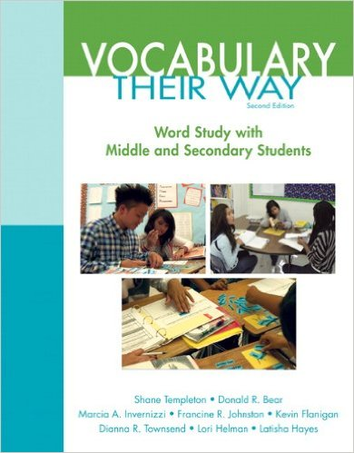
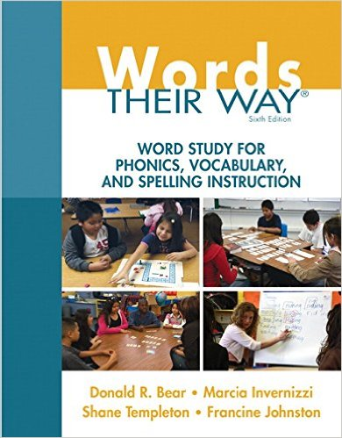
Resources

Slide 22
Resources
http://www.corestandards.org/assets/Appendix_A.pdf
http://www.secondstorywindow.net/
http://www.bigtimeliteracy.com/
http://textproject.org/
http://www.readingrockets.org/article/root-words-roots-and-affixes
http://www.vocabulary.com/ (for middle and high school students)
Notes:
Popular literacy blogs
Textproject – many common core resources – especially FREE vocab lessons “Expressions for Everyday” & “Super Synonym Sets for Stories”

Slide 23
Resources
http://www.asburypark.k12.nj.us/cms/lib7/NJ01001017/Centricity/Domain/110/Fourteen_Roots_That_Unlock_100,_000_Words%5B2%5D.pdf
http://www.marileesprenger.com/the-critical-words.html (55 high frequency CCSS words)
Online Games
http://www.vocabulary.co.il/
http://www.visuwords.com/
http://people.uncw.edu/ertzbergerj/ppt_games.html
http://reading.pppst.com/vocabulary.html

